Slide 1
Industrial training report on Implementation of personal Data protection policies On it applications at National informatics centre(HQ)
Department of Information Technology
Project Trainee Project Head/Mentor
NIKUNJ PANSARI DEEPAK GOEL
Cyber Security Researcher Legal Services Division
STD & HOD

Slide 2
ACKNOWLEDGEMENT
At the very outset, I am highly indebted to National Informatics Centre (HQ) under the Digital
India Internship Scheme-2018 for giving me an opportunity to carry out my project on
“Implementation of Personal Data Protection Policies in IT Applications” at their esteemed
organization. I would specially thank, Project Guide Deepak Goel, (STD & HOD-Legal Services
Division at NIC) for giving time and guidance throughout my project without whom it would have
been impossible to attain success.
I own my regards to the entire faculty of the Department of INFORMATION TECHNOLOGY at
KIET GROUP OF INSTITUTIONS from where I have learnt the basics of Information
Technology and whose informal discussions and able guidance was a become light for me in the
entire duration of this work.
I would also like to thank my colleagues who worked with me and our combined efforts lead to the
completion of the project.

Slide 3
ABSTRACT
Data Protection and Privacy is the most important concern of any organization or for an individual. Pertaining to the needs, standard rules and regulations are the prime factors for maintaining privacy of an individual & safeguard the interests of the organization’s personal data. Implementation of various IT Companies are working in different ways for its execution through varied principles and methods.
Personally Identifiable Information (PII) and to protect it under Personal Data Protection policies. Personal Data Protection requires companies to protect the privacy of their customers. That means keeping personally identifiable information (PII) safe.
Implementation of Data portability with existing policies and at the same time considering it with the security point of view also helps in maintaining the integrity and consistency at large scale.

Slide 4
Introduction
Personal Data Protection (in compliance with Data Protection Policies )
Method or Techniques of Personal Data Protection Policies
(Data Masking, Encryption, Pseudonimisation, Anonymization)
Real Time Analysis on NATIONAL SCHOLARSHIP PORTAL 2.0 (NSP 2.0)
Data Protection Compliance Report
Preparation for Personal Data Protection
Personal Data Protection Bill, 2018
Case Studies of Some Companies like TCS and Infosys, describing how they work about on Data Protection Policies for IT Applications.(Analysis)
Data Protection As a Service

Slide 5

What is Personal Data Protection?
Before we get to know about the Personal Data Protection policies and all its working and procedure ,we have to understand the concept of PII (Personally Identifiable Information).
Personal Data Protection requires companies to protect the privacy of their customers by protecting PII.
Personally identifiable information (PII) is any data that can be used to identify a specific individual. Social Security numbers, mailing or email address, and phone numbers have commonly been considered PII, but technology has expanded the scope of PII considerably. It can include an IP address, login IDs, social media posts, or digital images. Some times Geolocation, biometric, and behavioural data can also be classified as PII depending on the context..

Slide 6
Benefits of IT Implementation
Uniform instead of defragmented rules for personal data across the organization.
One IT application for securing the PII of an organization
Strengthen existing rights & introduce new laws to tackle the existing technological challenges for maintaining data privacy of individuals.
Transparency, accountability and self-regulation for strengthening the Data Protection Authority’s cooperation regarding sensitive data and PII.

Slide 7
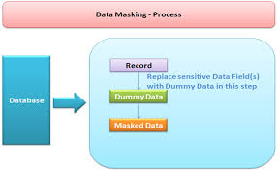
Techniques/Methods for Personal Data Protection
Data Masking

Slide 8

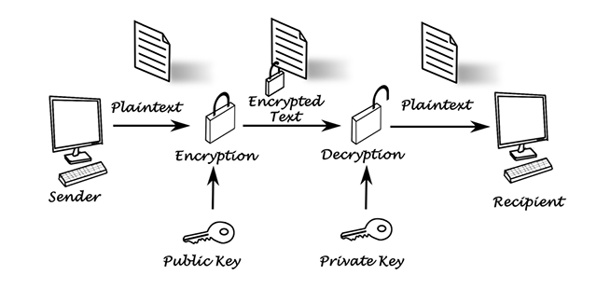
Encryption

Slide 9
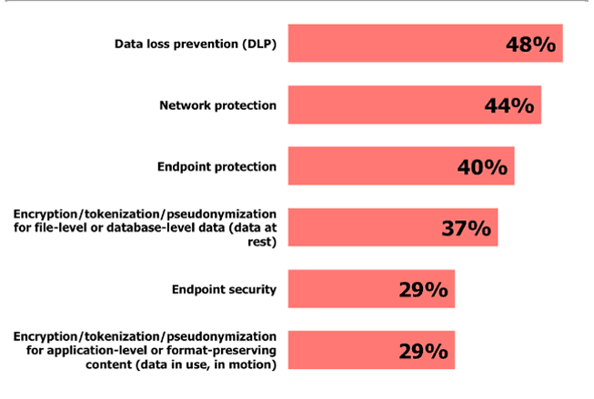
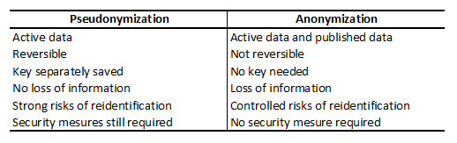
Anonymization & Pseudonimisation

Slide 10
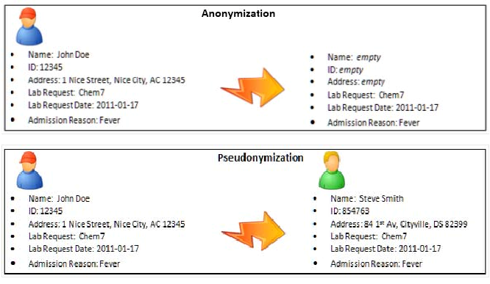

Slide 11
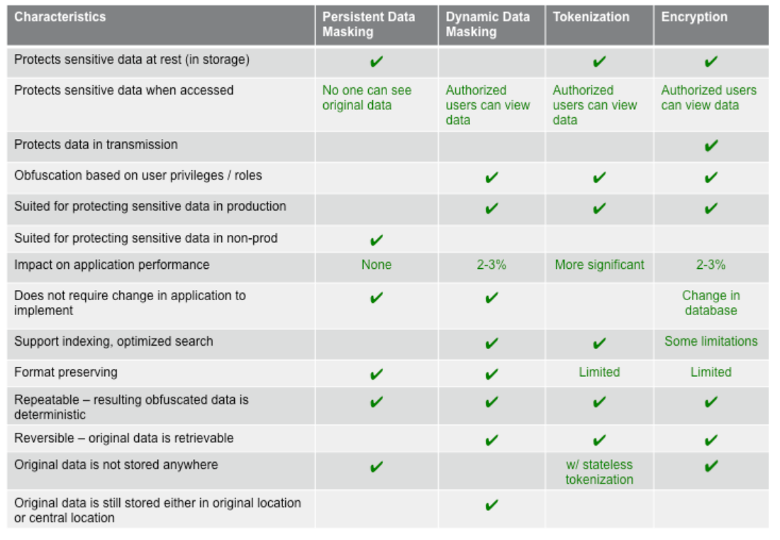

Slide 12
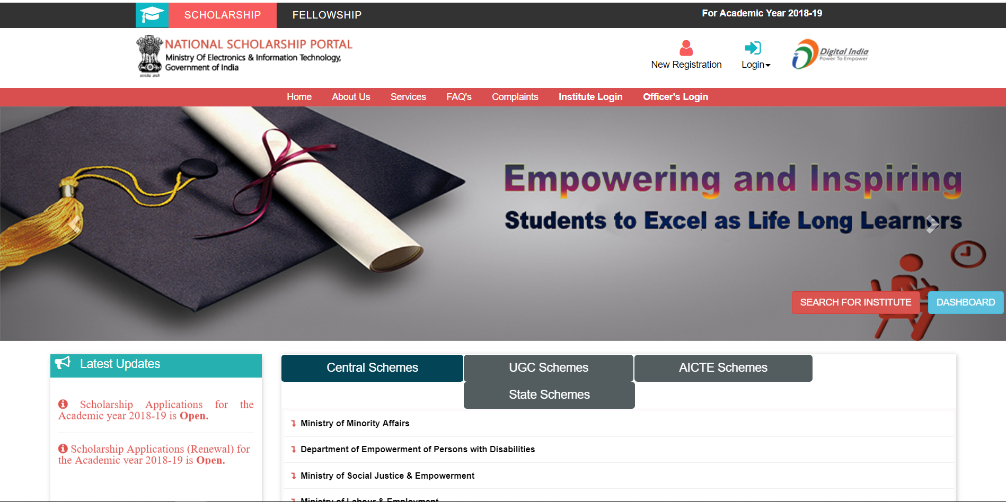
NATIONAL SCHOLARSHIP PORTAL 2.0(NSP 2.0)

Slide 13
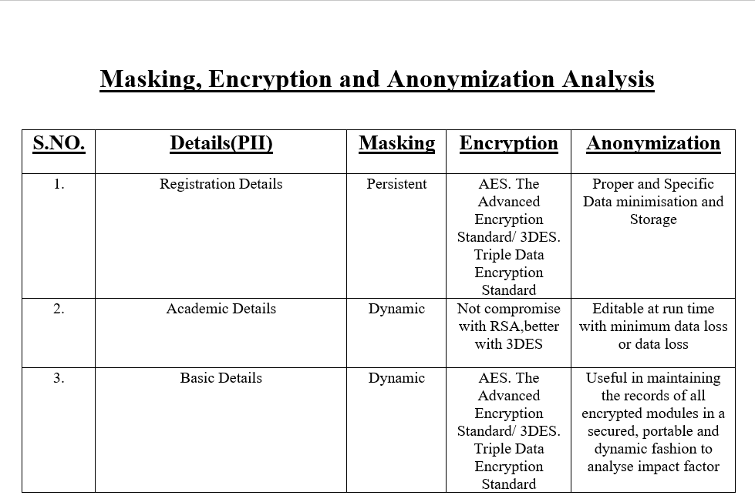
Data protection compliance report

Slide 14
Preparation for the Personal Data Protection
Review policies, procedures and existing privacy programmes.
Conduct personal data discovery exercises and maintain documentation in order to demonstrate visibility of the personal data processed.
Impart data privacy training to employees and outsourced agencies/manpower ;
Implement processes to perform/implement
Data protection impact assessments (DPIAs)
Manage data subject requests
Implement privacy by Design in Applications
Strengthen the Data Management Cycle specific to PII
Review/update contracts signed with Data Fiduciaries and third-party vendors.

Slide 15
Personal Data Protection Bill, 2018
Change in Terminology
Horizontal Application
Extra-Territorial Application
Personal Data
Sensitive Personal Data
Grounds for processing Personal Data
Grounds for processing Sensitive
Personal Data
Personal and Sensitive Personal Data
of Children
Data Principal Right
Transparency and Accountability Measures
Transfer of Personal Data Outside India
Conditions for Transfer of Personal Data Outside India
Data Protection Authority of India
Penalties, Remedies and Offences
Transition Provisions

Slide 16
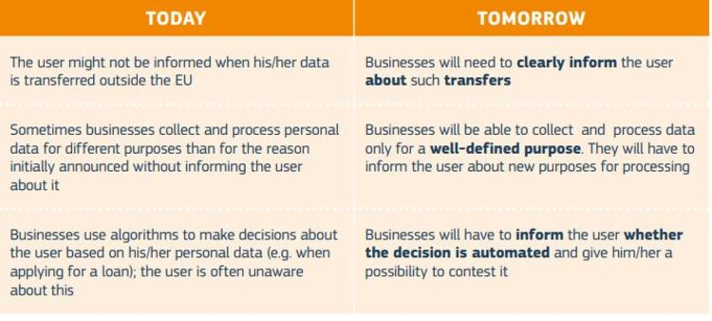

Slide 17
Case Study Analysis on Data Protection Policies (in accordance with TCS)
(A) IT Implementation point of View
Processing and Storing Personal Data
User Consent
Rights of the Data Subject
Data Protection by Design
(B) Post-Analysis IT Implementation or processing of PII
Records of Processing
Data Breach
Impact Assessments
Data Protection Officers(DPO)

Slide 18
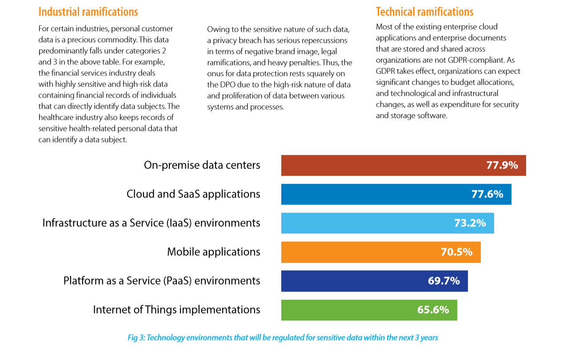
Personal Data Protection-An Industry and Geography agnostic regulation(Infosys)

Slide 19
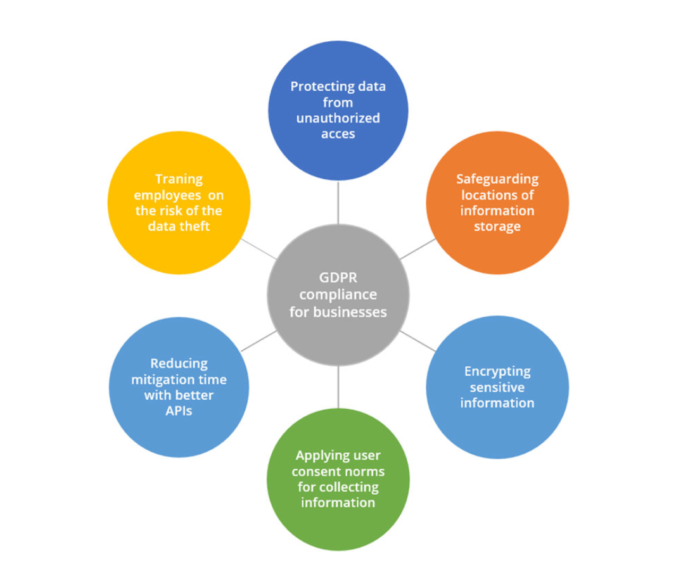
Ways technology can help businesses become Personal Data
Protection compliant
PDP

Slide 20
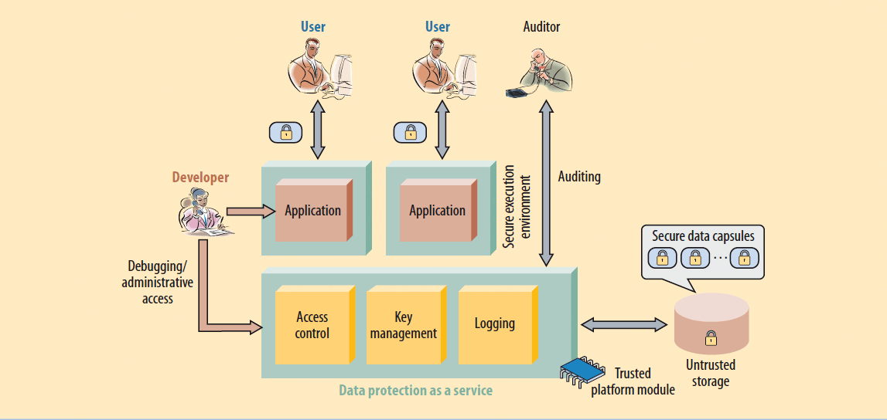
Data Protection as a Service
Data protection as a service (DPaaS) is a cloud-based or web-delivered service for protecting data assets. Companies can utilize this type of service to enhance network security and to build better security for data in transit and data at rest.

Slide 21
Thank You!!
For queries
nikunjpansari95@gmail.com
8393893227

